Slide 1

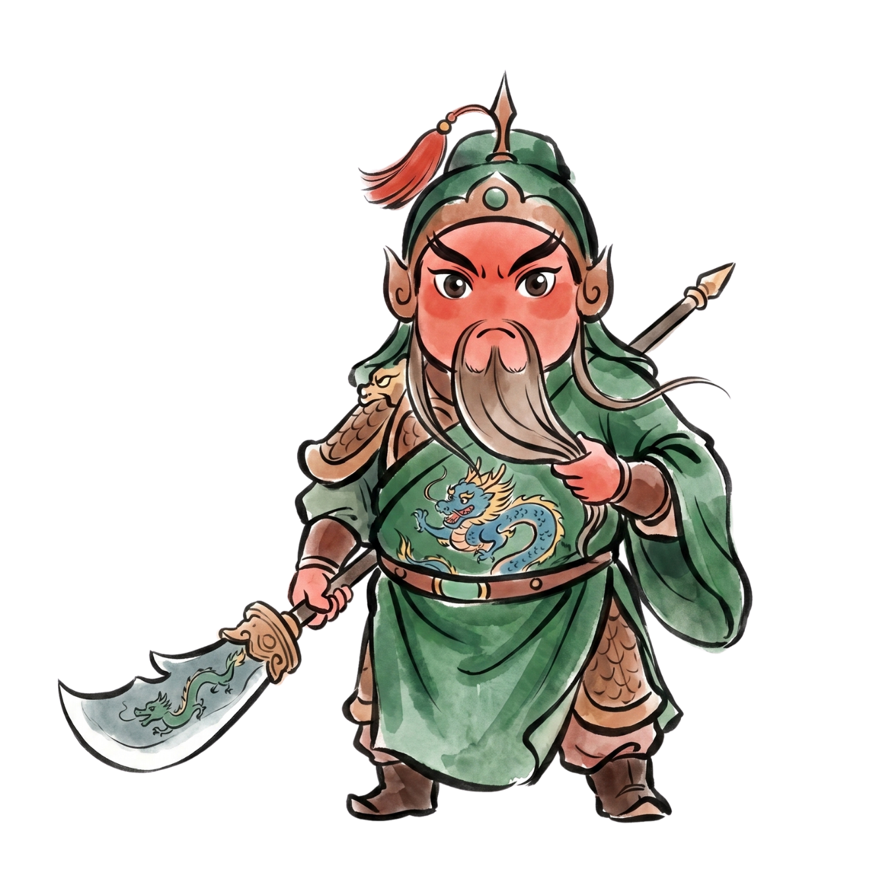

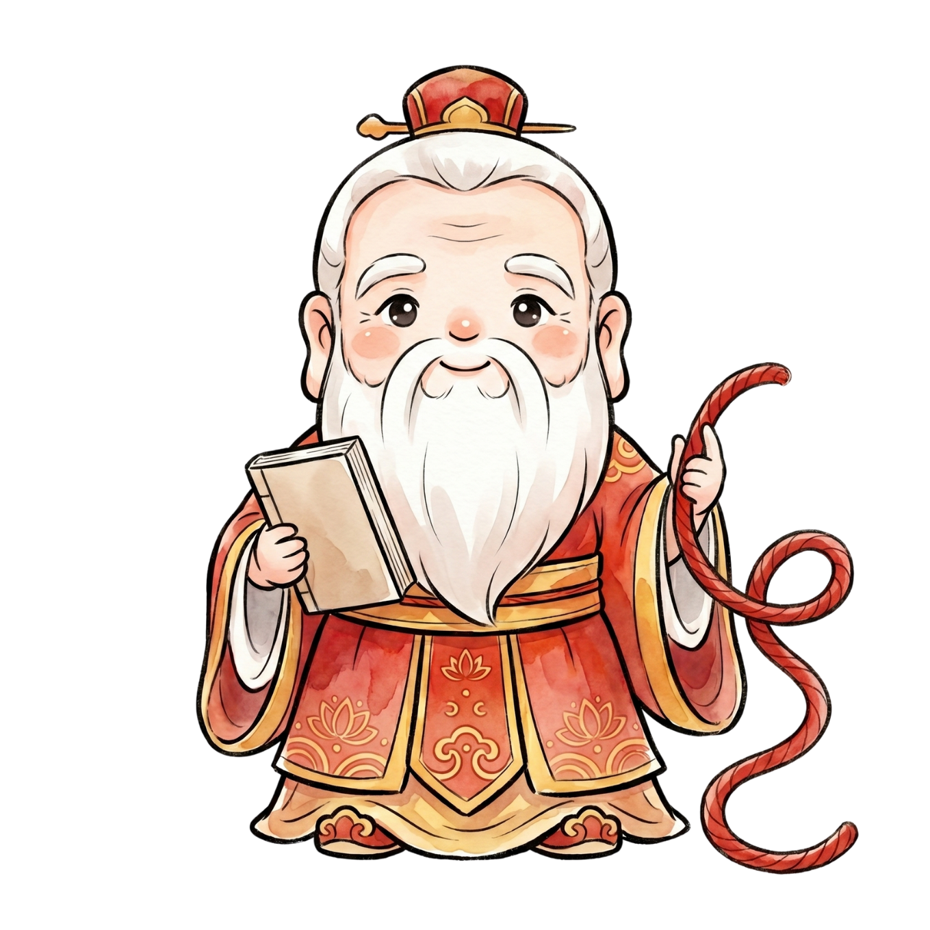

數位拜拜大挑戰
- 線上求籤與 AI 解籤 -
[Digital Temple Worship Challenge]
Online fortune stick drawing and AI interpretation!
Step1.
認識神明
(Meet the Gods)
關帝 / 關公
(關聖帝君)
媽祖
月老
(月下老人)
觀音
(觀世音菩薩)
Step2. 確認你的問題與神明 (Find the Right Deity for Your Question)
☑️ | 問題類型 (Category) | 祈求項目 (Items) | 適合祈求的神明(Recommended Deities)
□ | 學業 (Studies) | 考試順利 (Passing exams) 成績進步 (Improving grades)
□ | 感情/交友 (Romance & Friendship) | 交到好朋友 (Making friends)
 |  | 找到男女朋友 (Finding a boyfriend / girlfriend)
□ | 工作/財富 (Work & Wealth) | 找到好工作 (Finding a good job) 賺錢、發財 (Making money)
□ | 生活/健康 (Life & Health) | 身體健康 (Good health) 生活平安 (Peace and safety)

Slide 2


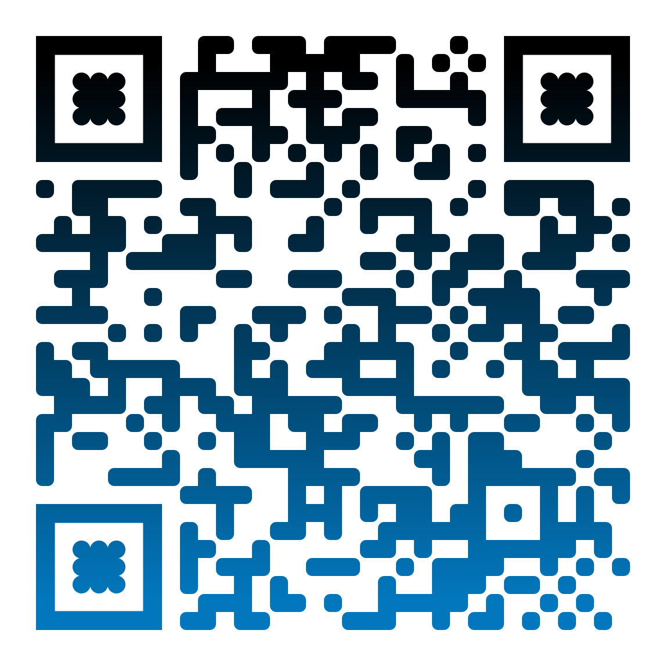
Step3. 寫下你的願望 / 問題
(Write Down Your Wish / Question)
姓名 (Name)：__________________
生日 (Birthday)：__________年__________月__________日
住址 (Address)：______________________________________________________
我的願望 / 問題 (My Wish / Question)：_________________________________
_____________________________________________________________________
_____________________________________________________________________
【願望範例】我下個󠇡月要考TOCFL考試，請保佑我考試順利！
[Wish Example] I am taking the TOCFL exam next month. Please bless me with success on my exam!
【問題範例】我下個󠇡月要考TOCFL考試，請問我能通過考試嗎？
[Question Example] I am taking the TOCFL exam next month. Will I be able to pass it?
※你可以不寫下生日和󠇡地址，可是你需要在心裡告訴神明這些資訊喔！
(※ You can skip writing your birthday and address, but remember to tell the gods these details silently in your heart!)
Step4. 線上求籤
(Online fortune stick drawing )
Step5. AI 解籤
(AI interpretation)
祝你擲出好運氣！
May your toss bring you good fortune!

Slide 3

籤詩開箱時間
Time to Reveal Your Fortune!
大家好！我今天非常虔誠地󠇡用線上求籤和󠇡擲筊的方法來請神明給我指示。
(1)因為󠇡 ______________________________________________________________，
所以我向〔 關帝 / 媽祖 / 月老 / 觀音 〕祈求了 _________________________
___________________________________________________________________
(2)因為󠇡 ______________________________________________________________，
所以我向〔 關帝 / 媽祖 / 月老 / 觀音 〕問了 ___________________________
___________________________________________________________________
神明給我的建議是：_____________________________________________________
_______________________________________________________________________
_______________________________________________________________________
聽完神明的指示，_______________________________________________________
_______________________________________________________________________
以上是我的籤詩開箱，謝謝󠇡大家！
(※ 上面的(1)、(2)只要選1個󠇡說就可以了。)
(※ You only need to say either (1) or (2) from above.)
以下的生詞最少要用3個󠇡。
神明 (deities, gods) | 祈求 (pray for) | 保佑 (bless and protect) | 平安 (safe and sound, well) | 求籤 (to draw a fortune stick)
擲筊 (to throw moon blocks) | 安慰 (comfort, console) | 人心 (the human heart, popular sentiment) | 作用 (function) | 指示 (indicate / instructions)
以下的語法最少要用1個󠇡。
隨著...，...也... (as [something happens], ...also...)
用...來... (use...to V. )

